Slide 1


Slide 2


Slide 3

OBJECTIVES:
To define Training and Development
To know the following:
    Training Programs
    Management Development Programs
    Training Strategy and Overview of Training Process
    How to Manage Organizational Change Programs
    Evaluate Training Efforts

Slide 4

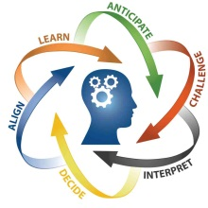
TRAINING AND DEVELOPMENT
Training and development is a function of human resource management concerned with organizational activity aimed at bettering the performance of individuals and groups in organizational settings. It has been known by several names, including "human resource development", and "learning and development".

Slide 5
Simple Model of the Training Process:
PARTICIPANT
improved participant behavior
TRAINING
ORGANIZATION
greater
organizational
effectiveness

Slide 6


Orienting and
Onboarding
New Employees
Orienting and Onboarding
New Employees

Slide 7
4 things you must accomplish in orienting new employees:
    Make the new employee feel welcome and at home and part of the team
    Make sure the new employee has the basic information to function effectively
    Help the new employee understand the organization in a broad sense
    Start the person on becoming socialized into the firm’s culture, values, and ways of doing things.

Slide 8

IMPLEMENTING TRAINING PROGRAMS

Slide 9

On-the-Job Training
having a person learn a job by actually doing it
sometimes called direct instruction
a one-on-one training located
at the job site, where someone
who knows how to do a task
shows another how to
perform it

Slide 10

THE OJT PROCESS
Prepare the learner
Present the operation
Do a tryout
Follow-Up

Slide 11


APPRENTICESHIP TRAINING
People become skilled workers, usually through a combination of formal learning and long-term on-the-job training
enable practitioners to gain a license to practice in a regulated profession

Slide 12

Informal learning
Learning the job through informal means,
including performing their jobs on a
daily basis with their colleagues
it has no set objective in terms
of learning outcomes and
is never intentional from
the learner’s standpoint
referred to as learning
by experience or
just as experience

Slide 13
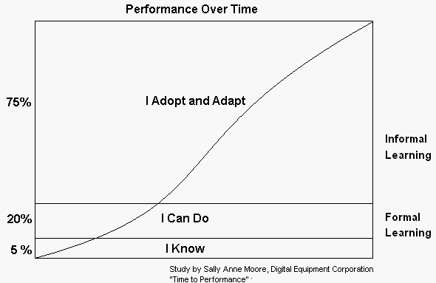

Slide 14
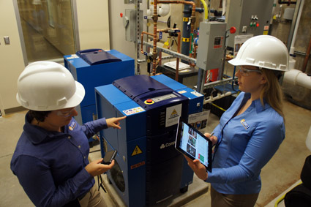
Job instruction training
Listing each job’s basic tasks, along with key points, in order to provide step-by-step training for employees
Preparation - prepares a trainee with an overview of the job, its purpose, and the results desired
Presentation - demonstrates the task or the skill to the trainee
Performance - allows the trainee to mimic the demonstration on his or her own, and
Follow-up - follows up to provide
feedback and help

Slide 15
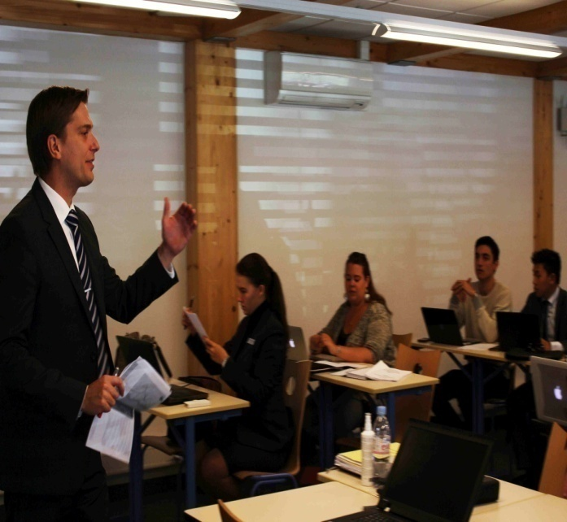
LECTURES
Lecturing is a quick and simple way to present knowledge to large groups of trainees.
Don’t start out on the wrong foot
Speak only about what you know well
Give your listeners signals
Use anecdotes and stories to show rather than tell
Be alert to your audience
Maintain eye contact with the audience
Make sure everyone in the room can hear
Control your hands
Talk from notes rather than from a script
Break a long talk into a series of short talks
Practice

Slide 16

Programmed learning
Whether the medium is a textbook, PC, or the Internet, programmed learning (or programmed instruction) is step-by-step, self-learning methods that consist of three parts:
Presenting questions, facts, or problems to the learner
Allowing the person to respond
Providing feedback on the accuracy of answers
Advantages:
Reduced training time
Self-paced learning
Immediate feedback
Reduced risk of error for learner

Slide 17
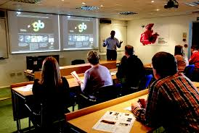
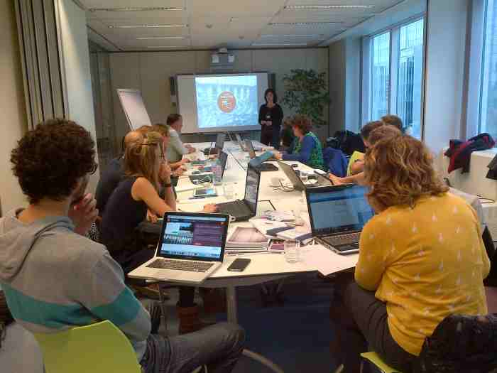
Audiovisual-based training
Techniques like DVDs, films, PowerPoint, and audiotapes
When there is a need to illustrate how to follow a certain sequence over time, such as when teaching a machine repair
When there is a need to show trainees events not easily demonstrable in live lectures.

Slide 18
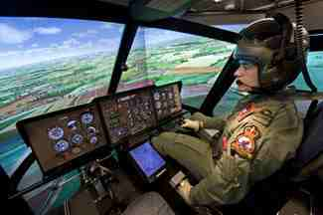
Vestibule training
Trainees learn on the actual or simulated equipment they will use on the job, but trained off the job.
Necessary when it’s too costly or dangerous to train employees on the job

Slide 19
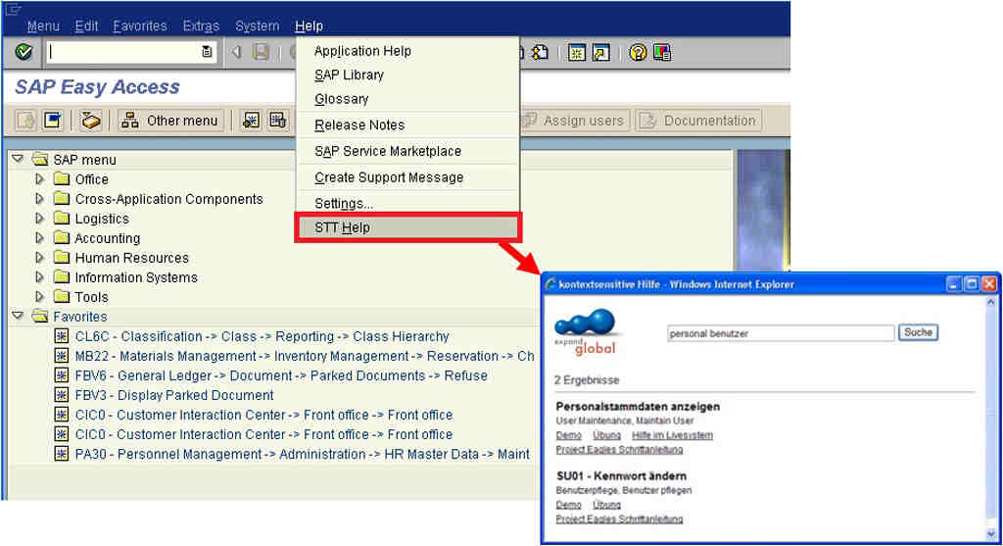
ELECTRONIC PERFORMANCE SUPPORT SYSTEMS (EPSS)
A performance support system provides just-in-time, just enough training, information, tools, and help for users of a product or work environment, to enable optimum performance by those users when and where needed, thereby also enhancing the performance of the overall business

Slide 20
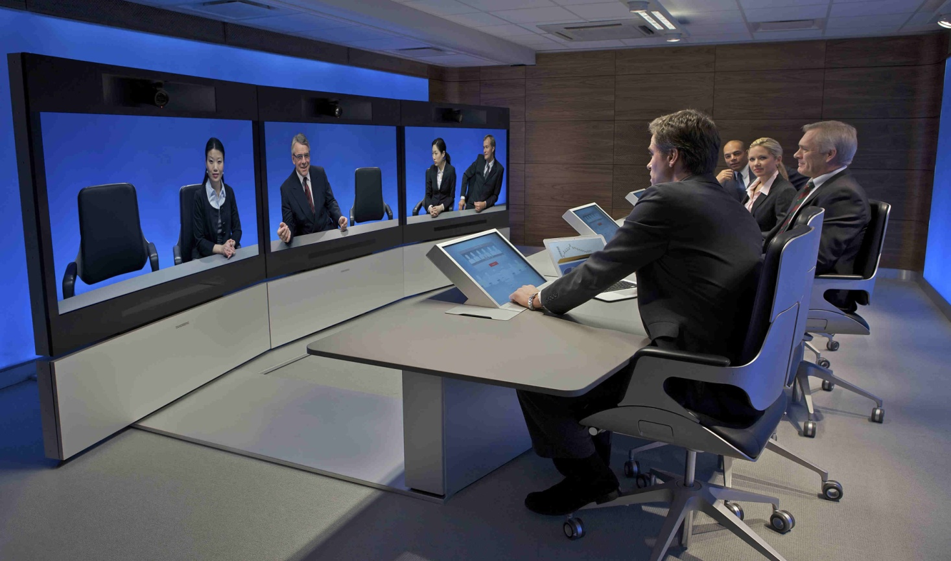
VIDEOCONFERENCING
A set of telecommunication technologies which allow two or more locations to communicate by simultaneous two-way video and audio transmissions

Slide 21

Computer-based training
refer to the use of modern tools, such as computers, digital technology, electronic media, networked digital devices and associated software and courseware with learning scenarios, worksheets and interactive exercises that facilitate learning

Slide 22


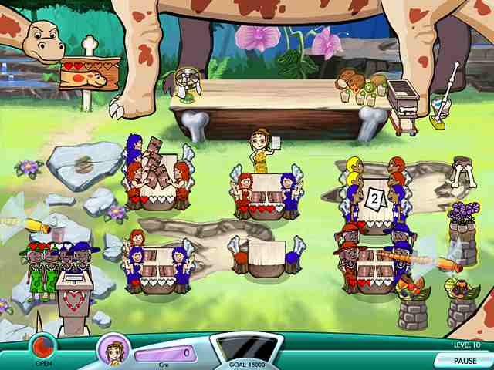
Interactive learning
is a pedagogical approach that incorporates social networking and urban computing into course design and delivery
Components of Interactive Learning
Social Media
Urban Computing
Serious Games

Slide 23


INTERNET-BASED TRAINING
Trainers increasingly employ Internet-based learning to deliver programs

Slide 24
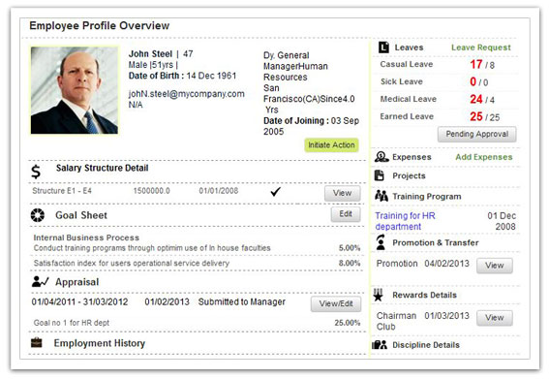
Learning management systems
Special software tools that support internet training by helping employers identify training needs, and in scheduling , delivering, assessing and managing the online training itself

Slide 25

MOBILE LEARNING
Means delivering learning content on demand via mobile devices like cell phones, laptops, and iPads, wherever and whenever the learner has the time and desire to access it.

Slide 26

Virtual classroom
Web-based learning trends to be limited to the sorts of online learning with which many students are already familiar- reading powerpoint presentations, participating in instant message type chat rooms, and taking online exams.

Slide 27
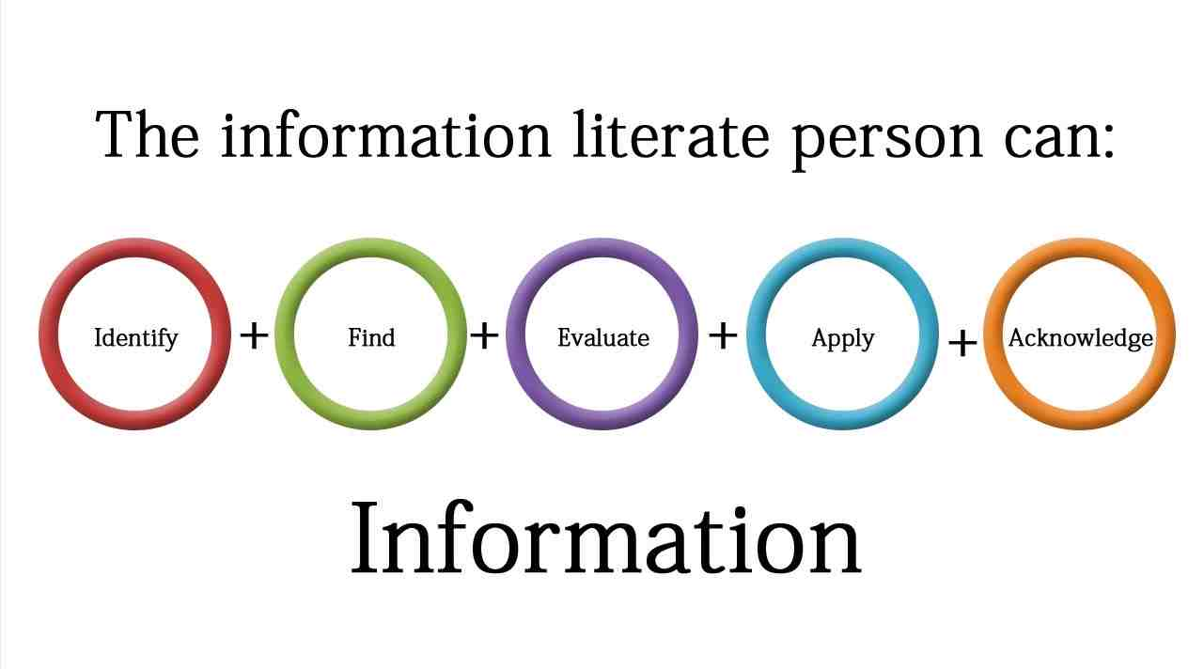
Lifelong and literacy training techniques
Means providing employees with continuing learning experiences over their tenure with the firm, with the aims of ensuring they have the opportunity to learn the skills they need to do their jobs and to expand their horizons

Slide 28
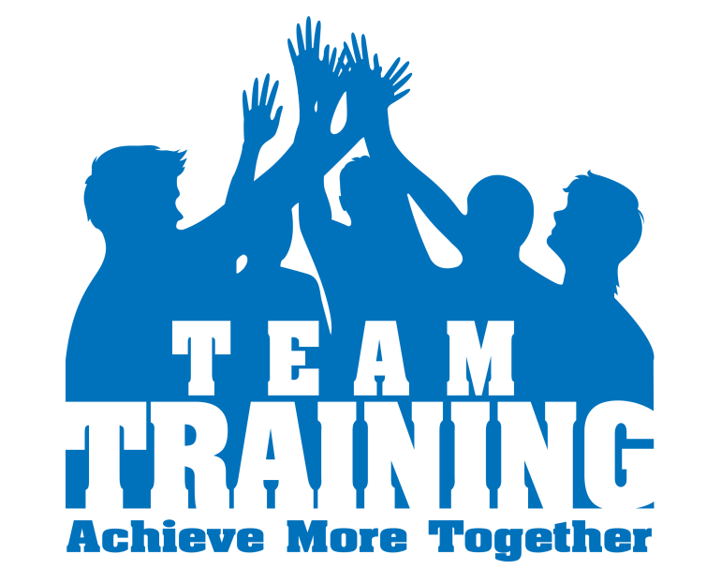
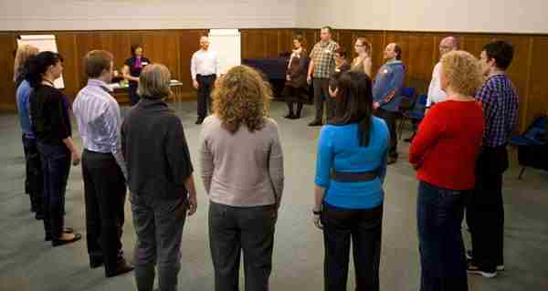
Team training
a group process intervention aimed at improving interpersonal relations and social interactions but over time has developed to include achieving results, meeting goals, and accomplishing tasks

Slide 29

IMPLEMENTING MANAGEMENT
DEVELOPMENT PROGRAMS

Slide 30
MANAGERIAL ON-THE-JOB TRAINING
Job rotation
  Moving managers from department to department to broaden their understanding of business and to test their abilities
Coaching/understudy approach
  Trainee works directly with a senior manager or with the person he or she is to replace; the latter is responsible for the trainee’s coaching
Action learning
  Give managers and others released time to work analyzing and solving problems in departments other than their own

Slide 31
OFF-THE-JOB MANAGEMENT TRAINING AND DEVELOPMENT TECHNIQUES
Case Study Method – presents a trainee with a written description of an organizational problem
Management Games – enable trainees to learn by making realistic decisions in simulated situations
Outside Seminars – numerous companies and universities offer Web-based and traditional classroom management development seminars and conferences
University-Related Programs – executive education and continuing programs in leadership, supervision, and the like
Role-playing – create a realistic situation and then have the trainees assume the parts of specific persons in that situation

Slide 32
Behavior Modeling – showing trainees the right way of doing something, letting trainees practice that way, giving feedback on the trainees’ performance
  Modeling
  Role Playing
  Social reinforcement
  Transfer of training
Corporate Universities (in-house development centers) – offer a catalouge of courses and programs aimed at supporting the employers’ management development needs
  Alignment with corporate strategic goals
  Focus on development of skills that support business needs
  Evaluation of learning and performance
  Using technology to support the learning
  Partnering with academia
Executive Coaches – to develop their top managers’ effectiveness, an outside consultant who questions the executive’s boss, peers, subordinates, and family in order to identify the executive’s strengths and weaknesses, and to counsel the executive so he or she can capitalize on those strengths and overcome the weaknesses
The SHRM Learning System – Society for Human Resource Management encourages HR professionals to qualify for certification by taking examinations

Slide 33
LEADERSHIP DEVELOPMENT AT GE
General Electric known for ability to develop executive talent
  Leadership programs
  Session C
  Crotonville
  Boca Raton
  The next big thing
  Monthly dinners

Slide 34
TALENT MANAGEMENT AND MISSION-CRITICAL EMPLOYEES: DIFFERENTIAL DEVELOPMENT ASSIGNMENTS
Most distinctive talent management best practice is to actively manage employees

Slide 35

Training Strategy and Overview of the Training Process

Slide 36
The addie 5 Step Training Process:
  Analyze the training need
  Design the overall training program
  Develop the course
  Implement training, by actually training the targeted employee group using methods such as on-the-job or online training
  Evaluate the course’s effectiveness

Slide 37

Conducting the training needs analysis
Strategic training Need Analysis
Current Training Analysis
Task Analysis
Talent Management
Performance Analysis
Can’t Do/ Won’t Do

Slide 38
Designing the training program
Setting learning objectives
Creating a motivational learning environment
Making the learning meaningful
Making skills transfer obvious and easy
Reinforcing the learning
Ensuring transfer of learning to the job

Slide 39
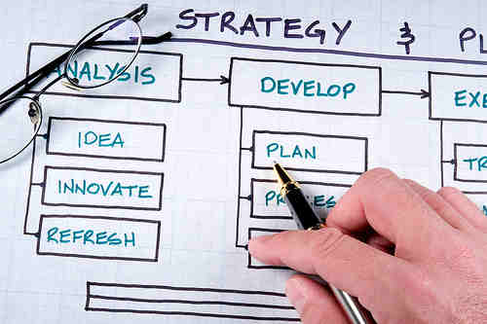

Developing the program
Means actually assembling/creating the program’s training content and materials.
Choosing the actual content the program will present, as well as designing/choosing the specific instructional methods you will use

Slide 40
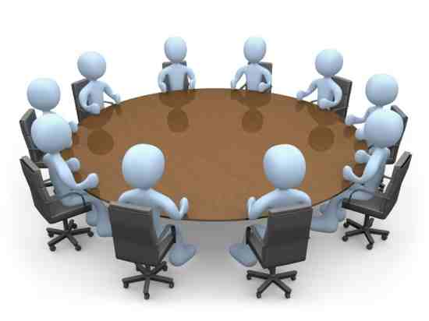
MANAGING ORGANIZATIONAL
CHANGE PROGRAMS

Slide 41

WHAT TO CHANGE
Strategic Change
Other Changes

Slide 42
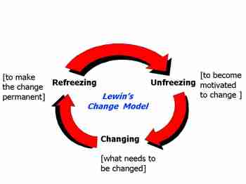
Lewin’s change process

Slide 43
Using organizational development
Human Process
Organizational confrontation meeting
Survey search
Process consultation
Team Building
Human Resource
Management
Goal Setting
Performance appraisal
Reward systems
Career planning
and development
Employee wellness
Technostructural
Formal structural
change
Cooperative union-
management projects
Total quality
management
Work Design
Strategic
Integrated strategic
management
Culture change
Strategic change
Self-designing
organizations

Slide 44

EVALUATING THE TRAINING
EFFORT

Slide 45
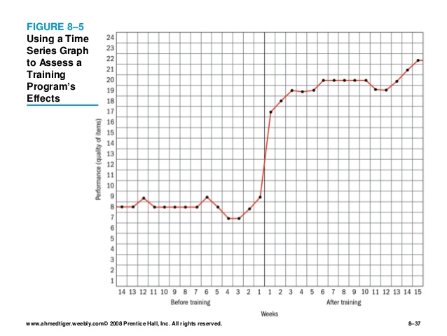
DESIGNING THE STUDY
Controlled experimentation

Slide 46
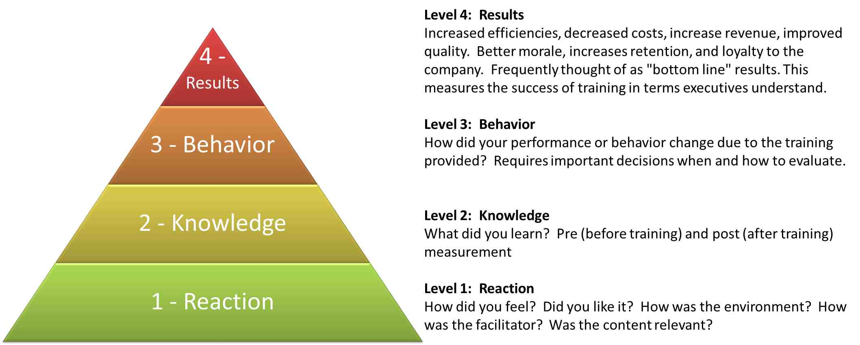
Training effects to measure

Slide 47
Importance of training and development:
Individual – help employees in achieving their personal goals, which in turn, enhances the individual contribution to an organization.
Organizational – assist the organization with its primary objective by bringing individual effectiveness.
Functional – maintain the department’s contribution at a level suitable to the organization’s needs.
Societal – ensure that an organization is ethically and socially responsible to the needs and challenges of the society.

Slide 48


Slide 49

Thank you
For
Listening!
☺
- Jessan A. Polido -

