Slide 1
Human Resources Management
Module 6: Recruitment and Selection
Notes:
Cover Image: "Untitled." Authored by: rawpixel. Provided by: Pixabay. Located at: https://pixabay.com/en/squad-man-group-group-together-3370836/. Content Type: CC Licensed Content, Shared Previously. License: CC0: No Rights Reserved.
All text in these slides is taken from https://courses.lumenlearning.com/wmopen-humanresourcesmgmt/ where it is published under one or more open licenses.
All images in these slides are attributed in the notes of the slide on which they appear and licensed as indicated.

Slide 2
Module Learning Outcomes
Assess various recruitment and selection strategies, processes, and laws
6.1: Discuss the recruitment process
6.2: Discuss recruiting sources
6.3: Discuss how to avoid discrimination in the recruiting process
6.4: Discuss the selection process

Slide 3
The Recruitment Process

Slide 4
Learning Outcomes: The Recruitment Process
6.1: Discuss the recruitment process
  6.1.1: Discuss the recruitment process
  6.1.2: Discuss the importance of employer branding
  6.1.3: Discuss how to build your brand as an employer
  6.1.4: Create a compelling job advertisement

Slide 5

Understanding The Recruitment Process
Recruitment requires a clear understanding of what makes the company unique as well as the type of employee it wants to attract
  Factors contributing to workers’/job seekers’ perception of long-term potential: transparency about pay, information about growth opportunities, internal promotion track record, positive employee reviews
  Factors most likely to prompt an application: attractive benefits, convenient commute, relatively high salary
  Factors most likely to prompt candidate to abort recruitment process: layoff announcement, negative interactions with recruiter or negative employee reviews, leadership or employee scandals
Notes:
Modification of Avatar Photos. Authored by: Coffee Bean. Provided by: Pixabay. Located at: https://pixabay.com/illustrations/avatar-customers-photos-ecommerce-3127928/. License: CC0: No Rights Reserved. License Terms: Pixabay License

Slide 6
The Recruitment Process, continued
Female respondents were more likely to cite CEO misbehavior as a reason to exit recruitment and to rate poor customer service and negative employee reviews as detracting factors
Optimize the Candidate Experience through aspects of the job application process contributing to a positive experience: clear and regular communication, clear expectations, and feedback regarding rejection
Greatest causes of frustration during the interview process: lack of information about pay and benefits, interview schedule changes, untimely responses, and lack of information about job responsibilities
Recruiting occurs after human resource planning and before selection
To be effective, the recruiter should have a complete job description that includes job specifications, essential functions, and an ability to speak to other details
Planning points to consider include evaluating your employer brand, identifying candidate sources, evaluating related technologies and cultivating passive candidates

Slide 7
Employer Branding
A positive employer brand is important because it affects an organization’s ability to attract and retain talent and has financial and productivity implications
A nationally representative survey of full-time professionals found that candidate choices are increasingly based on employer brand
The contributing factors to a bad reputation: lack of job security, dysfunctional teams, and poor leadership
The contributing factors to a good reputation: stability, career growth opportunity, ability to work with a high-performing team
Researchers determined that the minimum premium required to convince a candidate to take a job with a bad reputation was 10%
Almost half of respondents indicated they would not consider taking a job with a company exhibiting the three negative factors

Slide 8
Employer Branding, continued
It is important to have a good brand as an employer and to build your brand
  Step I. Evaluate your brand: Conduct surveys to determine what prospective employees think of your brand and the company as a place to work
  Step 2. Identify/Clarify your employer proposition: Know what inspires your employees to drive through the gate every day to allow accurate brand communication
  Step 3. Connect with your audience: Send the right message to the right people through the right medium
  Step 4. Recruit & support brand ambassadors: Provide employees with engaging, shareable content and encourage them to share and amplify their efforts
Organizations need to create a workplace where people want to work every day
Disengaged employees are estimated to cost US companies $450 - $550 billion annually in lost productivity

Slide 9
Writing a Job Advertisement
To advertise for a job, it is important to understand what the job entails and is often done with the help of an I/O psychologist
Job analysis through a task-oriented approach lists the details of tasks to be performed for the job
A worker-oriented approach describes the characteristics required of the worker to successfully perform the job (KSAs) and is also called job specification
Observation, surveys, and interviews are used to obtain information required for both types of job analysis
Research suggests that the accuracy and reliability of job analysis depends on the nature of the descriptions and the source for the job analysis
O*Net is a database that can be used to identify KSAs for different positions

Slide 10
Writing a Job Advertisement, continued
Employment branding can be defined through corporate culture clarification, understanding the market position, setting performance expectations, and helping candidates determine if they would be a good fit
In order to make a job advertisement compelling, you must make an emotional connection with the candidate:
  Write a compelling headline
  Craft a compelling hook
  Write with a specific person in mind
  Pitch the position with emotion and key facts
  Tell the company’s story
  Sell the area
  Summarize, selling the package
  Call to action
  Have someone from the target audience read it and comment

Slide 11
Tips to Writing a Good Job Description
• Be sure to include the pertinent information:
◦ Title
◦ Department
◦ Reports to
◦ Duties and responsibilities
◦ terms of employment
◦ qualifications needed
• Think of the job description as a snapshot of the job.
• Communicate clearly and concisely.
• Make sure the job description is interesting to the right candidate applying for the job.
• Avoid acronyms.
• Don’t try to fit all job aspects into the job description.
• Proofread the job description

Slide 12
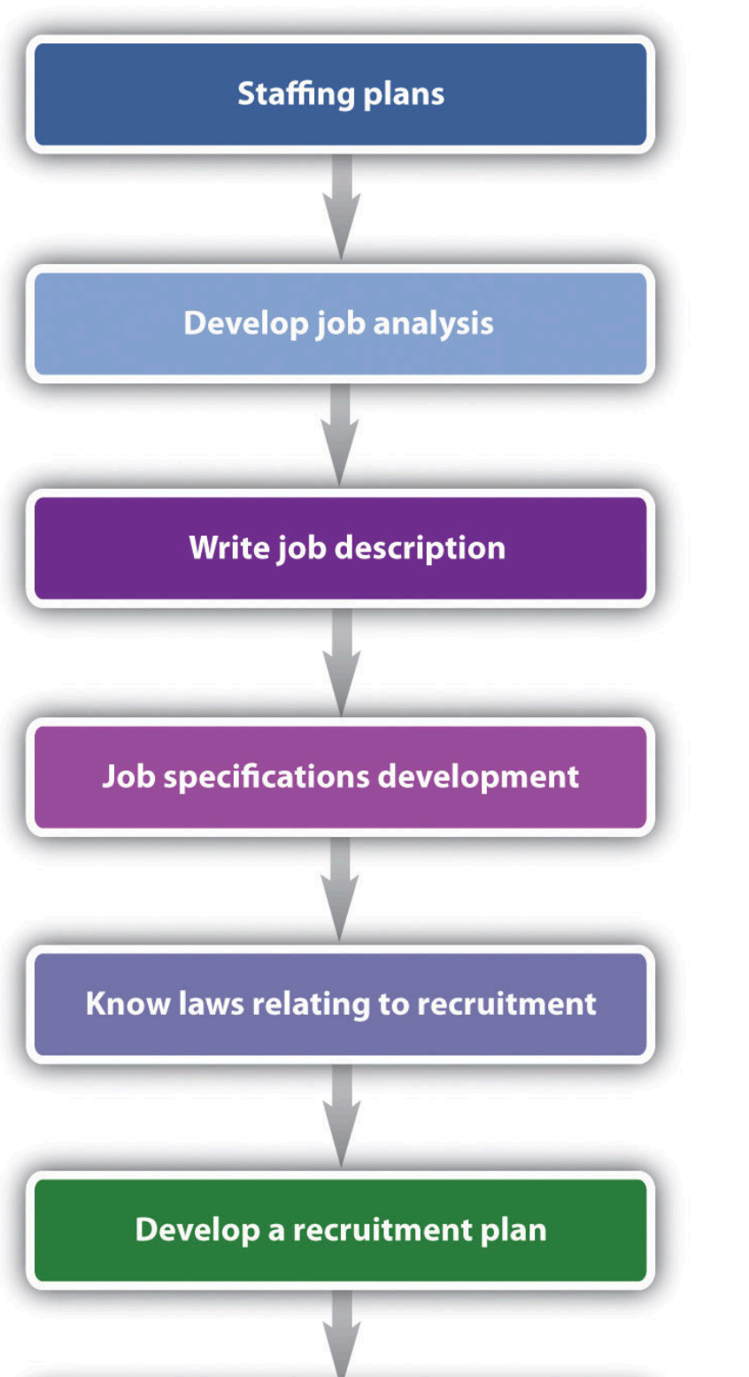

Slide 13
Practice Question 1
A worker-oriented approach to job analysis includes which of the following?
The characteristics of current employees.
The characteristics required of the worker to successfully perform the job.
The detailed tasks performed for the job.
Potential career pathways related to the job.
Notes:
Answer is B

Slide 14
Recruitment Sources

Slide 15
Learning Outcomes: Recruitment Sources
6.2: Discuss recruiting sources
  6.2.1: Discuss candidate sourcing
  6.2.2: Discuss the use of technology in recruiting

Slide 16
Candidate Sourcing
Sourcing is the process of identifying, pre-screening and cultivating qualified candidates in order to meet current and anticipated future job openings
Internal candidates requires training and development but allows you to pull known talent and build loyalty among existing employees
Tapping into social media is essential with the use of specific social media platforms different depending on age, gender, and educational attainment
Employee referrals are essential but be aware that:
  the employee might mistakenly assume job performance competence based on friendship
  may lead to nepotism or hiring individuals who are related to employees
  employee referrals may reinforce the status quo

Slide 17

Candidate Sourcing, continued
Face-to-face methods serve to build the employer brand as well as the candidate pool
LinkedIn groups that are relevant and following thought leaders or groups on Twitter can be beneficial for finding high-potential candidates
Candidates can also be identified through niche sites that specialize in a specific industry
Notes:
Untitled. Authored by: rawpixel. Provided by: Pexels. Located at: https://www.pexels.com/photo/woman-holding-plastic-arrow-while-smiling-1169951/. License: CC0: No Rights Reserved

Slide 18
Technology and Recruiting
Automate job board processes by leveraging available automation tools
Build a talent pool by developing an internal database of qualified candidates to reduce third-party recruiter dependence and allowing HR personnel to build relationships with a pre-qualified talent pool
Socialize the search to connect with and engage candidates
Recruiting software can assist with the evaluation and selection process by collecting applicant information and allowing for filtering, grading, and matching candidate skills against job requirements
Recruiting tools can help organize and disseminate information across multiple channels and job boards and reduce the time it takes to arrive at a short-list of qualified applicants
Incorporating robotics, AI, and cognitive computing are increasing automation

Slide 19
Practice Question 2
Which of the following candidate sourcing options has the added benefit of serving as continuous learning for the organization?
Joining a relevant LinkedIn group to build interest in the organization.
Having current employees refer potential candidates.
Tapping into social media.
Using internal sourcing options to find the ideal candidate.
Notes:
Answer is A

Slide 20
Avoiding Discrimination

Slide 21
Learning Outcomes: Avoiding Discrimination
6.3: Discuss how to avoid discrimination in the recruiting process

Slide 22
Avoiding Discrimination in Recruiting
HR personnel should evaluate their advertising and use of employee recruiting, screening, testing, and selection techniques to avoid intentional discrimination but also practices that have an “adverse impact”
The EEOC states that it is illegal for an employer to publish a job advertisement showing a preference for or discouraging someone from applying because of race, color, religion, sex, national origin, age, disability, or genetic information
It is illegal for an employer to engage in recruiting practices that have a discriminatory impact
Civil Rights Act of 1964 Title VII: permits employment tests unless they are designed, intended, or used to discriminate and applies to employers and employees
Title VII prohibits “disparate treatment” and “disparate impact” discrimination

Slide 23
Avoiding Discrimination in Recruiting, continued
Compliance with Title I of the Americans with Disabilities Act (ADA) should be reviewed to determine whether potential discrimination is present
Any disparate impact must be job-related and consistent with business necessity
Tests should be selected and administered in a manner that accurately reflects job-related aptitude or skills and not an impairment
Employers are required to make reasonable accommodations for known physical or mental limitations of an otherwise qualified candidate unless it imposes an undue hardship
ADEA prohibits both disparate treatment (intentional) and disparate impact discrimination based on age, such as requiring applicants older than 50 take agility or cognitive tests

Slide 24
Practice Question 3
Miguel wants to use an employment test as part of the recruitment process for a new engineering position. He asks the HR department whether he can add a test with engineering problems to be given to every candidate. What is important to consider to make sure the tests do not discriminate?
That the questions are formatted the same.
That there is an answer key available.
That there is no evidence of bias.
That tests are only given to candidates with a particular skill set.
Notes:
Answer is C

Slide 25
Selection Process

Slide 26
Learning Outcomes: Selection Process
6.4: Discuss the selection process
  6.4.1: Discuss the selection process
  6.4.2: Discuss how to avoid discrimination in the selection process
  6.4.3: Discuss how to avoid perceptual errors (unconscious bias) in the selection process
  6.4.4: Discuss various interviewing approaches

Slide 27
The Selection Process
The selection process involves moving candidates through the recruiting process and identifying the best candidates for the job
Screening and assessment techniques are used to eliminate candidates not meeting stated minimum requirements or who aren’t a good fit
Face-to-face interviews should be highly qualified and ideally a promising fit from a cultural standpoint
  Evaluation by Association: using the posting location as an initial screen
  Application: review of the cover letter, resume, and application and may include review of the candidates business or social networking profiles
  Assessment: a preliminary assessment of skills
  Screening Interview: an initial telephone interview to assess the candidate’s objective and motivate, relevant education, and experience
  External Verification: of educational qualifications and reference check
Automated candidate screening can reduce time to hire, increase candidate quality and experience

Slide 28

Avoiding Bias in Selection
The EEOC’s Uniform Guidelines on Employee Selection Procedures governs the employee selection procedure consistent with applicable legal standards and validation standards
The guidelines apply to most private and public employers and all selection procedures
The guidelines do not have bearing on recruiting procedures or practices
Employers should administer tests and other selection procedures without discrimination
Employers should ensure that employment screening procedures are properly validated
Notes:
Modification of Untitled. Authored by: Jhonatan_Perez. Provided by: Pixabay. Located at: https://pixabay.com/vectors/resume-unemployed-job-unemployment-2163673/. License: CC0: No Rights Reserved. License Terms: Pixabay License

Slide 29
Avoiding Bias in Selection, continued
Keep abreast of changes in job requirements and update test specifications or selection procedures accordingly
When reviewing a final slate of candidates, it’s important to be aware of the potential for perception errors and unconscious bias
Interviewers make decisions about candidates rapidly but also tend to overrate ability to evaluate others
A common mistake is judging candidates based on a first impression or “likeability” and interviewer bias or unconscious bias
Studies have conclusively shown that bias impacts almost every variation of human identity
Unconscious bias can also be a factor in the pre-screening process
Two approaches to reduce bias include awareness and designing approaches that help us make decisions more consciously

Slide 30
Interview Approaches
Traditional interview approaches include one-on-one, panel, and series, with the most common interview approach being one-on-one
Panel interviews are a standard practice in academia and business, with a committee composed of several interviewers meeting with the candidate at the same time
Series interviews evaluate the candidate one-on-one with multiple interviewers
Regardless of the format, those involved in the interview process should be trained in effective interviewing techniques and what questions are prohibited
To avoid litigation and have the best results, interview questions should be relevant to the position, consistent across candidates, and focus on the job duties, relevant skills and qualifications, and related success factors

Slide 31
situational interview questions
1. If you saw someone stealing from the company, what would you do?
2. One of your employees is performing poorly, but you know he has some personal home issues he is
dealing with. How would you handle complaints from his colleagues about lack of performance?
3. A coworker has told you she called in sick three days last week because she actually decided to take a
vacation. What would you do?
4. You are rolling out a new sales plan on Tuesday, which is really important to ensure success in your
organization. When you present it, the team is lukewarm on the plan. What would you do?
5. You disagree with your supervisor on her handling of a situation. What would you do?

Slide 32
behavior description interview questions
1. Tell me about a time you had to make a hard decision. How did you handle this process?
2. Give an example of how you handled an angry customer.
3. Do you show leadership in your current or past job? What would be an example of a situation in which
you did this?
4. What accomplishments have given you the most pride and why?
5. What plans have you made to achieve your career goals?

Slide 33
Class Activity: Interview Process
Think back to your most recent job search and interview and discuss the following:
  What was the process like as a candidate?
  Was there any pre-employment screening such as a test or activity?
  What type of interview did you have?
  Whether you were offered a job or not, what was the most useful part of your interview? What did not work well?
  Did you experience any bias? If so, how did you respond?
Notes:
Notes for instructor

Slide 34
Present: Interview Process

Slide 35
Quick Review
What is important in the recruitment process?
How is employer branding important?
How do you build your brand as an employer?
What is included in a compelling job advertisement?
What is involved in candidate sourcing?
How is technology used in recruiting?
How is discrimination avoided in the recruiting process?
What is included in the selection process?
How do you avoid discrimination in the selection process?
How do you avoid perceptual errors (unconscious bias) in the selection process?
What are various interviewing approaches?

