Slide 1
Human Resources Management
Module 2: Human Resource Strategy and Planning
Notes:
Cover Image: "Untitled." Authored by: rawpixel. Provided by: Pixabay. Located at: https://pixabay.com/en/squad-man-group-group-together-3370836/. Content Type: CC Licensed Content, Shared Previously. License: CC0: No Rights Reserved.
All text in these slides is taken from https://courses.lumenlearning.com/wmopen-humanresourcesmgmt/ where it is published under one or more open licenses.
All images in these slides are attributed in the notes of the slide on which they appear and licensed as indicated.

Slide 2
Module Learning Outcomes
Discuss how management theory, strategic analysis, competitive strategy and execution impact human resource management strategy and planning.
2.1: Discuss the foundations of human resource management
2.2: Discuss the strategic management process
2.3: Discuss human resource strategic planning

Slide 3
Foundations of Human Resources Management

Slide 4
Learning Outcomes: Foundations of Human Resources Management
2.1: Discuss the foundations of human resource management
  2.1.1: Discuss classical scientific management theories
  2.1.2: Discuss administrative management theory
  2.1.3: Discuss behavioral management theories
  2.1.4: Discuss modern management theories

Slide 5
Scientific Management Theories
Dr. Frederik Taylor, considered the “father of scientific management”, argued that systematic management was the remedy to inefficiency
Taylor’s four principles of scientific management include:
  Apply scientific method for work analysis to determine task efficiency
  Match workers to jobs based on capability and motivation, then train for efficiency
  Provide instruction and supervision to ensure “best” methods for tasks
  Divide work between managers (planning, training) and workers (production)
Dr. Lillian and Frank Gilbreth also focused on task efficiency and used film to identify opportunities to improve work processes
Frank categorized human work as a number of individual motions (Therbligs) that could then be optimized and Lillian is credited with a number of inventions related to home economics and domestic management

Slide 6
Administrative Management Theories
Henri Fayol developed administrative management theories, proposing 14 principles of management:
Current theory has modified his original management duties: planning, organizing, staffing, leading, controlling, and motivating
Division of Work | Unity of Direction | Scalar Chain | Initiative
Authority | Subordination of Individual Interests | Order | Esprit de Corps
Discipline | Remuneration | Equity
Unity of Command | Centralization | Stability of Tenure of Personnel

Slide 7
Behavior Management Theories
Behavioral management theory is sometimes referred to as the human relations movement due to its focus on the human dimension of work
Mary Parker Follett: proposed that conflict could be a stimulus for innovation and coined terms “power-over” and “power-with”
Follett’s theory of management included that principles of genuine power are coactive not coercive, and true leaders create group power rather than personal power
Elton Mayo: “Hawthorne Effect” marked a radical change in motivational theory and management practice
The Hawthorne studies observed workers in a social context and determined that employee performance is influenced by the work environment and co-workers as well as innate ability

Slide 8
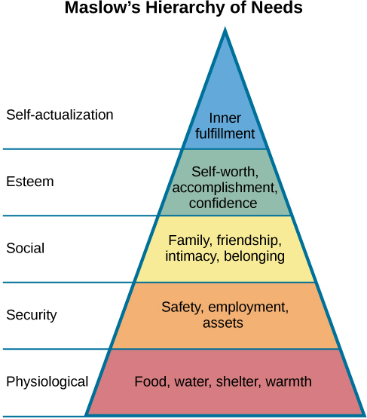
Behavior Management Theories, continued
Maslow proposed that people are motivated by five categories of needs
Maslow classified the bottom four levels ”deficiency needs” that result in anxiety when not met
The fifth level is a “growth need” because it enables self-actualization
Human behavior is purposeful and motivated by the desire to satisfy needs, with the unmet needs being the primary motivators
Notes:
Image: Maslow's Hierarchy of Needs. Provided by: OpenStax CNX. Located at: http://cnx.org/contents/Sr8Ev5Og@5.52:MLADqXMi@5/Motivation. License: CC BY: Attribution. License Terms: Download for free at http://cnx.org/contents/4abf04bf-93a0-45c3-9cbc-2cefd46e68cc@5.48

Slide 9
Modern Management Theories
Current management thinking incorporates ideas from administrative, behavioral, and scientific management, factoring in operating realities and available technology
Developed by Donald Schön, learning organizations focus on being systems capable of bringing about their own continuing transformation
Dr. Peter Senge proposed the theory of the learning organization, stating that organizations need to discover how to tap people’s commitment and capacity to learn at all levels
Quantitative Management focuses on data-driven decision making, using mathematical techniques and technology – data analysis, information modeling, computer modeling – to improve decision making
Quantitative techniques are generally developed and used to inform management rather than as a school of management

Slide 10
Practice Question 1
Margie is working with others in the HR department to implement a learning organization focus. What is one thing that she might include?
Defined authority to management to supervise employees
Focus on creating group power in each department
Identify which needs are important to meet for growth
Methods that will tap into people’s capabilities to learn as a team
Notes:
Answer is D

Slide 11
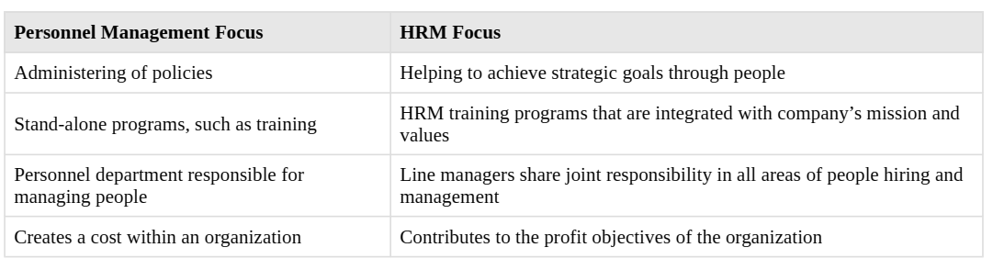
Difference between Personnel & HR management

Slide 12
Strategic Management

Slide 13
Learning Outcomes: Strategic Management
2.2: Discuss the strategic management process
  2.2.1: Describe strategic analysis
  2.2.2: Describe strategy formulation
  2.2.3: Describe strategy implementation

Slide 14
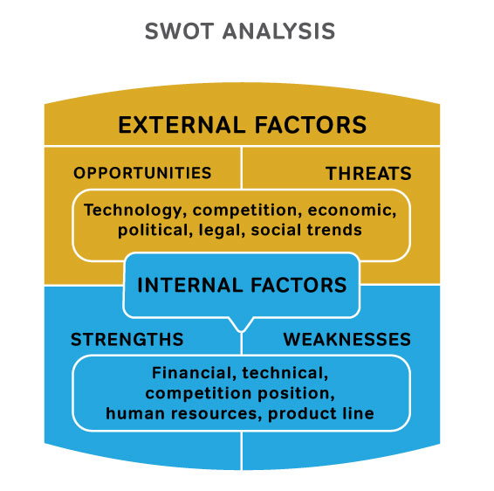
Strategic Analysis
An organization’s mission is its purpose or reason for existence
Core values are the formal expression of the organization’s beliefs and what it values
Core values articulate what an organization stands for and thus inform a range of business decisions
If there is a disconnect between lived culture and stated values, the culture will undermine efforts to achieve the mission
The essential situational analysis tool is the SWOT analysis (strengths, weaknesses, opportunities, and threats)
Notes:
Image: SWOT Analysis. Provided by: Lumen Learning. Located at: https://courses.lumenlearning.com/wmopen-introductiontobusiness/chapter/planning/. License: CC BY: Attribution

Slide 15
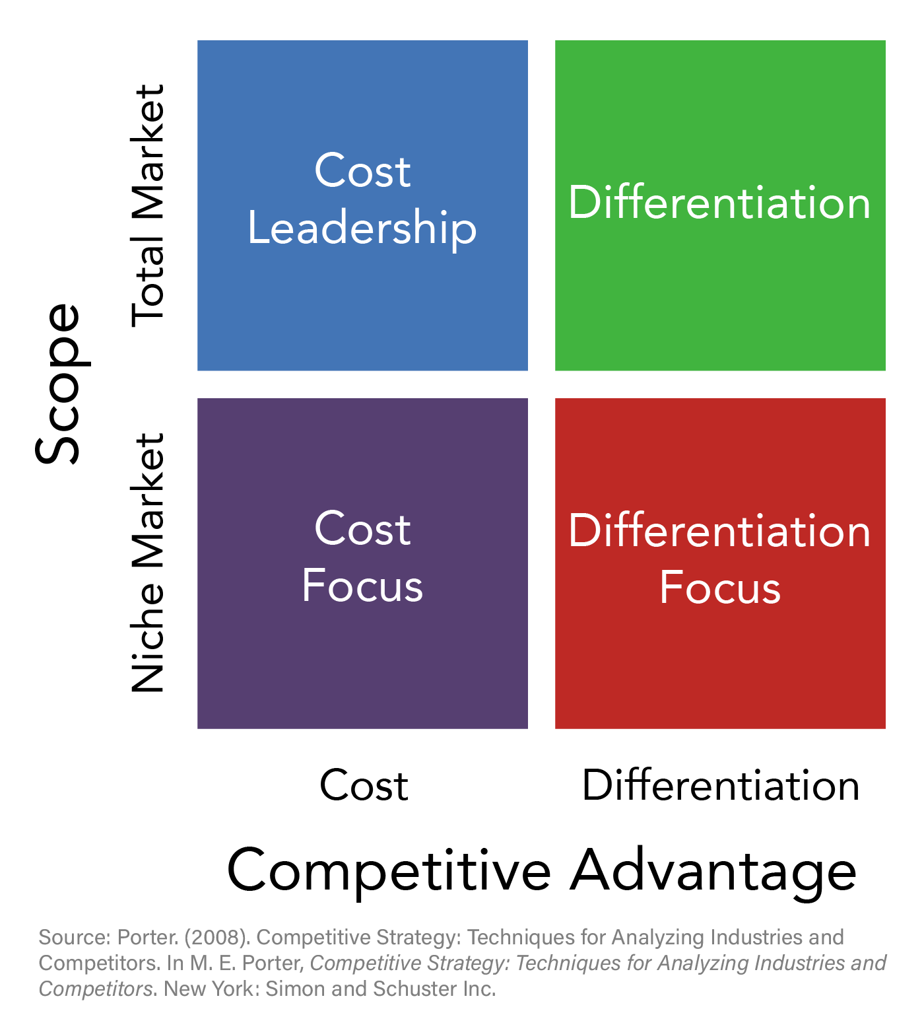
Strategy Formulation
Strategy formulation involves converting the inputs from the strategic analysis into the business plan
Michael Porter developed the classic strategy formulation model (Porter’s Generic Competitive Strategies)
The organizational goal is to differentiate the firm and its products or services based on one or more attributes that consumers value that it can uniquely deliver
A focus strategy has two variants: cost and differentiation
Cost focus strategy seeks to be the lowest cost producer in the market segment while differentiation is based on the specific consumer requirements
Notes:
Image: Porter 2019s Generic Competitive Strategies. Provided by: Lumen Learning. License: CC BY: Attribution

Slide 16
Strategy Implementation
The implementation phase is where the competitive strategy is translated into strategic goals and objectives with associated accountability metrics and timelines
The choice of strategy has implications for human resources structure, policies and practices, with alignment being the key to successful implementation
For example, the US Government Accountability Office (GAO) shows alignment of strategic goals with objectives
  The human capital plan seeks to maximize the value of the GAO by improving the agency’s efficiency and effectiveness as a responsible steward of resources and enhancing knowledge, agility, and response time

Slide 17
Strategic Planning

Slide 18
Learning Outcomes: Strategic Planning
2.3: Discuss human resource strategic planning
  2.3.1: Describe the role of human resource management in organizational strategic planning
  2.3.2: Describe the HR implications of different organizational strategies
  2.3.3: Describe the process of human resource planning

Slide 19
Identify Strategic HR Issues
Many organizations and departments will use a strategic planning tool that identifies strengths, weaknesses, opportunities, and threats (SWOT analysis) to determine some of the issues they are facing.
Once the alignment of the company SWOT is completed, HR can develop its own SWOT analysis to determine the gaps between HR’s strategic plan and the company’s strategic plan.
Based on the data gathered in the last step, the HRM manager should prioritize the goals and then put action plans together to deal with these challenges.
Writing the HR plan

Slide 20
Organizational Strategic Planning
Human resource management plays an instrumental role in both the development and implementation of organizational strategy
HR also provides insight into external human capital risks and opportunities based on their evaluation of legal, market, societal, technological, and geopolitical factors
Attracting, Retaining, & Developing Critical Talent: Recruiting and selecting talent, develop capabilities of current talent, address needs/interests of multigenerational workforce
Building high performance work organizations: establish accountability for business results, align reward systems with priorities, build values and principles for long-term growth
Aligning people with the business: Involve employees in business planning, building more effective communication and coaching, focus efforts on growth, markets, and customer retention
An organization’s go-to-market strategy has implications for the organization’s structure and HR systems, policies, and practices

Slide 21
The Process of Human Resources Planning
HR Management is responsible for developing human capital strategies that align with the organization’s mission, goals, and objectives
HR strategy sets the direction for all key areas including hiring, performance management, compensation, and training & development
Essential elements of personnel management include:
  A clearly understood strategic direction
  Customer and stakeholder human capital management outcomes/goals
  Strategies/objectives for accomplishing the goals
  Implementation plan
  Communication/change management plan
  Accountability system
Data collection should support the identification of key themes associated with gaps between current and desired workforce and human capital functions

Slide 22
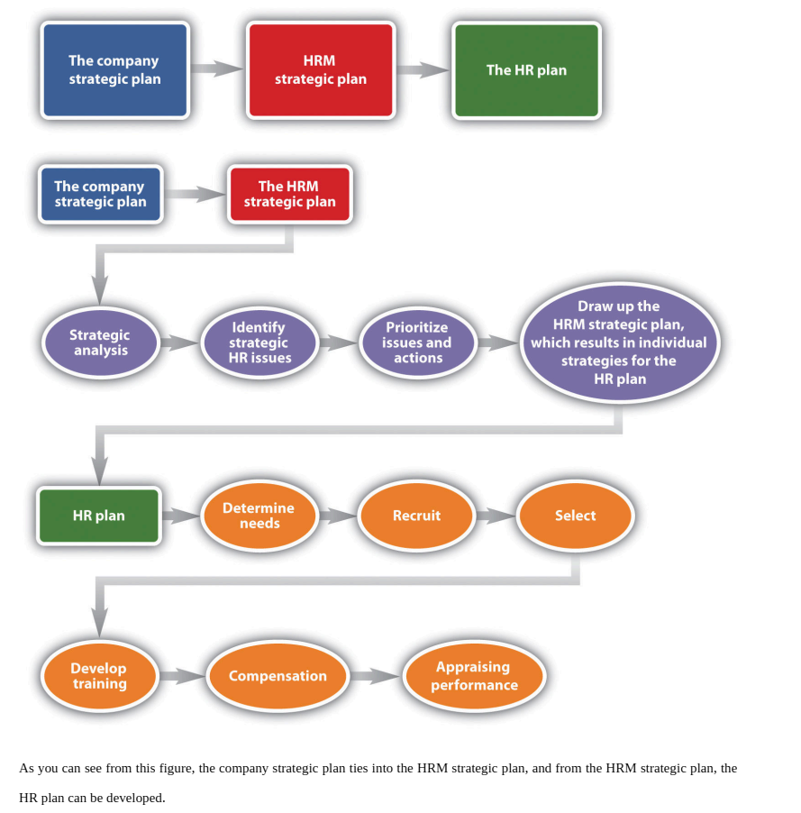
The six parts of the
HRM plan
Determine human resource needs.
Determine recruiting strategy.
Select employees.
Develop training.
Determine compensation
Appraise performance.

Slide 23
Class Activity: Strategic Planning
Divide into groups of 3–4 people
Consider the following essential elements for a personnel management planning guide:
  A clearly understood strategic direction
  Customer and stakeholder human capital management outcomes/goals
  Strategies/objectives for accomplishing the goals
  An implementation plan
  A communication/change management plan, if needed
  An accountability system
Pick at least two elements and discuss how you would approach this in your current organization or a well-known public company thinking about how the organization currently approaches personnel management planning
Are there elements that are more important than others? Why or why not?
Notes:
Notes for instructor

Slide 24
Present: Strategic Planning

Slide 25
Quick Review
What are the classical scientific management theories?
What is the administrative management theory?
What is assumed by behavioral management theories?
What are the assumptions of modern management theories?
What is strategic analysis?
What is strategy formulation?
What is strategy implementation?
What is the role of human resource management in organizational strategic planning?
What HR implications arise from different organizational strategies?
What is included in the process of human resource planning?

